Slide 1
Section 2.2
One Quantitative Variable: Shape and Center

Slide 2
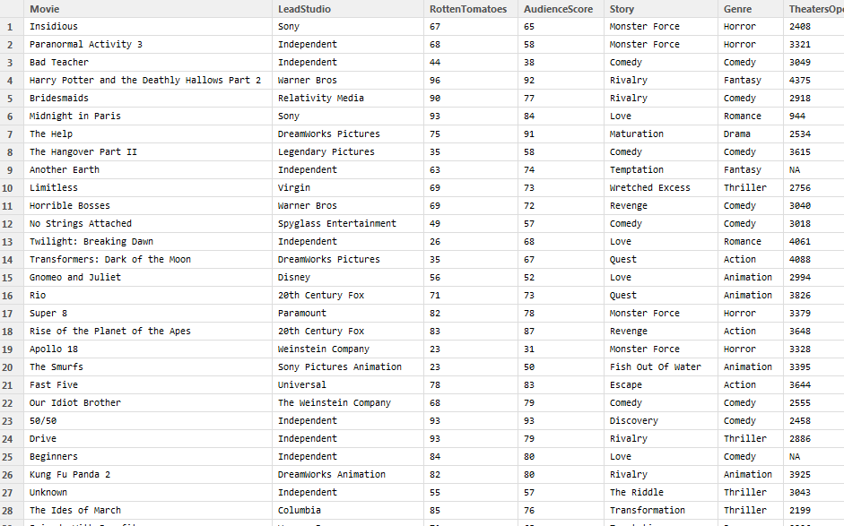
Hollywood Movies2011

Slide 3
One Quantitative Variable
We need summary statistics and visualizations that show the center, spread, and shape of the quantitative data.

Slide 4
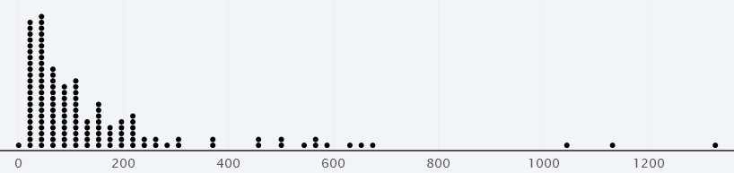
Dotplot
In a dotplot, each case is represented by a dot and dots are stacked.
Easy way to see each case
Notes:
Highest is Harry Potter and the Deathly Hallows Part 2
Second is Transformers
Third: Pirates of the Caribbean: On Stranger Tides

Slide 5
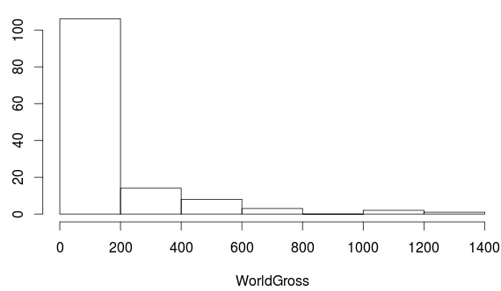
Histogram
The height of the each bar corresponds to the number of cases within that range of the variable

Slide 6
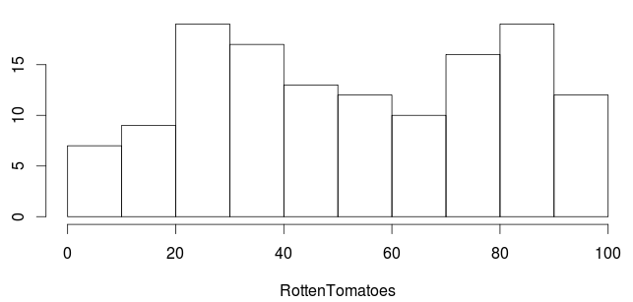
This is a
Histogram
Bar chart
Other
I have no idea

Slide 7
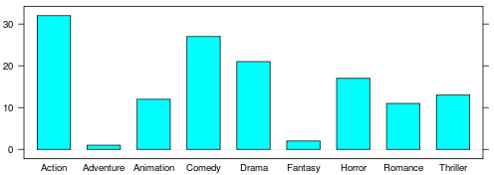
This is a
Histogram
Bar chart
Other
I have no idea

Slide 8
Histogram vs. Bar Chart
A bar chart is for categorical data, and the x-axis has no numeric scale
A histogram is for quantitative data, and the x-axis is numeric
For a categorical variable, the number of bars equals the number of categories, and the number in each category is fixed
For a quantitative variable, the number of bars in a histogram is up to you (or your software), and the appearance can differ with different number of bars

Slide 9
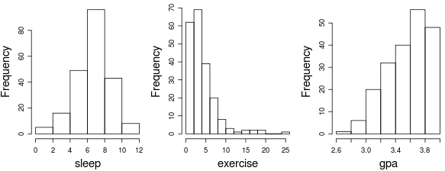
Shape
Long right tail
Symmetric
Right-Skewed
Left-Skewed

Slide 10
Demonstration: Measures of Center
We have 5 stacks of blocks with heights 1, 3, 3, 6, and 7.
We would like to describe the typical value (or center) of the height data. Describe multiple methods that we could use to do so.

Slide 11
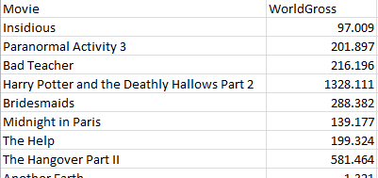
Notation
The sample size, the number of cases in the sample, is denoted by n
We often let x or y stand for any variable, and
x₁ , x₂ , …, x_{n} represent the n values of the variable x
Ex) x₁ = 97.009, x₂ = 201.897, x₃ = 216.196, …

Slide 12
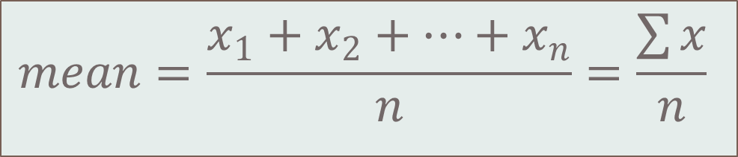
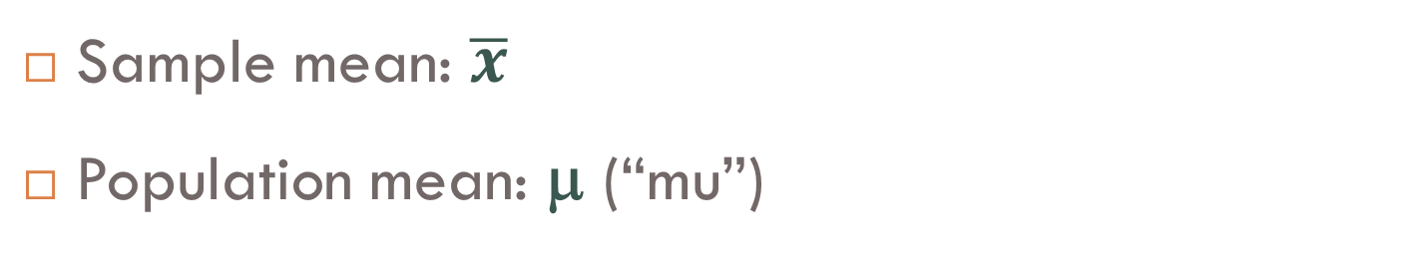
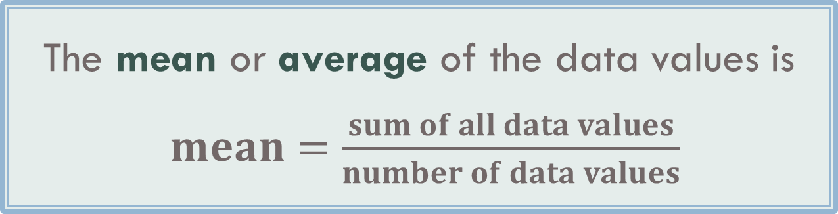
Mean
The mean or average of the data values is
$mean=\frac{sum of all data values}{number of data values}$
$$mean=\frac{x_{1}+x_{2}+…+x_{n}}{n}=\frac{\sum{x}}{n}$$
Sample mean: $\overline{x}$
Population mean: μ (“mu”)

Slide 13
Median
The median, m, is the middle value when the data are ordered.
If there are an even number of values, the median is the average of the two middle values.
The median splits the data in half.

Slide 14
Measures of Center
m = 76.66
Mean is “pulled” in the direction of skewness
μ =150.74
World Gross (in millions)

Slide 15
A distribution is left-skewed. Which measure of center would you expect to be higher?
Mean
Median

Slide 16
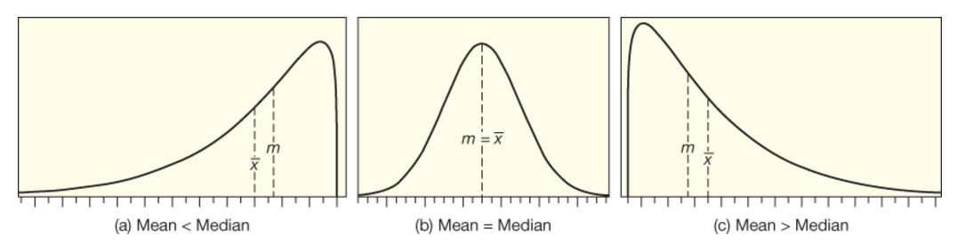
Skewness
Skewed Left
Symmetric and Bell-Shaped
Skewed Right

Slide 17
The distribution of 2010-11 NHL Salaries is shown, in millions of dollars. The distribution is:
Symmetric
Skewed right
Skewed left

Slide 18
The distribution of 2010-11 NHL Salaries is shown. Which is larger, the mean or the median?
The mean
The median

Slide 19
The mean is approximately (in millions of dollars)
0.46
1.25
2.21
4.35
5.0

Slide 20
The median is approximately (in millions of dollars)
0.46
1.25
2.21
4.35
5.0

Slide 21
Outlier
An outlier is an observed value that is notably distinct from the other values in a dataset. Values that are considered outliers will be much larger or much smaller than the rest of the data values.

Slide 22
Outliers
Transformers
Harry Potter
Pirates of the Caribbean
World Gross (in millions)

Slide 23
Resistance
 | 1 |  |  | 1
 | 2 |  |  | 2
 | 3 |  |  | 3
 | 7 |  |  | 7
 | 8 |  |  | 8000000
Mean | 4.2 |  | Mean | 1600003
Median | 3 |  | Median | 3

Slide 24
Resistance
A statistic is resistant if it is relatively unaffected by extreme values.
The median is resistant while the mean is not.
 | Mean | Median
With Harry Potter | $150,742,300 | $76,658,500
Without Harry Potter | $141,889,900 | $75,009,000

Slide 25
Outliers
When using statistics that are not resistant to outliers, stop and think about whether the outlier is a mistake
If not, you have to decide whether the outlier is part of your population of interest or not
Usually, for outliers that are not a mistake, it’s best to run the analysis twice, once with the outlier(s) and once without, to see how much the outlier(s) are affecting the results

Slide 26
Example: Normal Body Temperature
It is commonly believed that “normal” human body temperature is 98.6°F (or 37°C). In fact, “normal” temperature can vary from person to person, and for a given person it can vary over the course of a day.
The table on the next slide gives a set of temperature readings of a healthy woman taken over a two-day period.
(cont’d…)

Slide 27
Example: Normal Body Temperature
97.2 | 97.6 | 98.4 | 98.5 | 98.3 | 97.7
97.3 | 97.7 | 98.5 | 98.5 | 98.4 | 97.9
Make a dotplot of the data.
Compute the mean of the data and locate it on the dotplot as the balance point.
Compute the median of the data and locate it on the dotplot as the midway point.
http://lock5stat.com/statkey/

Slide 28
Summary
Visualizing one quantitative variable:
Dotplot
Histogram
Shape:
Symmetric
Skewed
Measures of center:
Mean (not resistant to outliers)
Median (resistant to outliers)

